Slide 1
Chapter – Graphs
Topic 9

Slide 2
Outline
Introduction
Undirected Graphs
Directed Graphs
Weighted Graphs
Common Graph Algorithms
Strategies for Implementing Graphs
1-<number>

Slide 3
Introduction
Graphs are data structures rather like trees.
In fact, in a mathematical sense, a tree is a kind of graph. However, in computer programming, graphs are used in different ways than trees.
Graphs are nonlinear structures in which nodes may be connected to many other nodes, with no particular parent/child relationships
1-<number>

Slide 4
Cont..
Graphs often have a shape dictated by a physical problem.
For example, nodes in a graph may represent cities, while edges may represent airline flight routes between the cities.
In graph, nodes are called vertices (the singular is vertex)
1-<number>

Slide 5
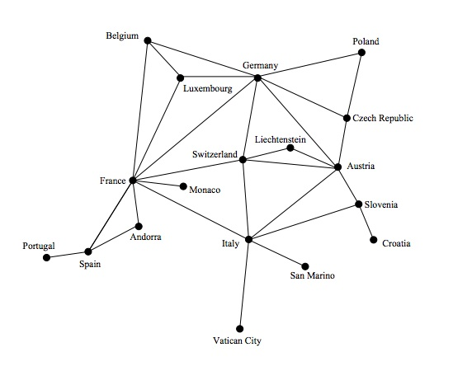
Example of Graph
Vertices are typically referenced by a name or label
Edges are referenced by a pairing of the vertices (A, B) that they connect
An edge in an undirected graph can be traversed in either direction
1-<number>

Slide 6
Cont..
The circles are vertices, and the lines are edges.
Each edge is bounded by the two vertices at its ends.
Adjacency means two vertices are said to be adjacent to one another if they are connected by a single edge,
Paths is a sequence of edges, for example, a path from vertex Portugal to Monaco that passes through vertices Spain and France, we can call this path (Portugal, Spain, France, Monac).
1-<number>

Slide 7
Undirected Graphs
The length of a path is the number of edges in the path (or the number of vertices – 1)
An undirected graph is considered connected if for any two vertices in the graph there is a path between them
A
B
D
C
An example undirected graph that is not connected
1-<number>

Slide 8
An Undirected Graph
A
B
An edge of a graph that connects a vertex to itself is called a self-loop or sling
An undirected graph is considered complete if it has the maximum number of edges connecting vertices
D
C
1-<number>

Slide 9
Outline
Undirected Graphs
Directed Graphs
Weighted Graphs
Common Graph Algorithms
Strategies for Implementing Graphs
1-<number>

Slide 10
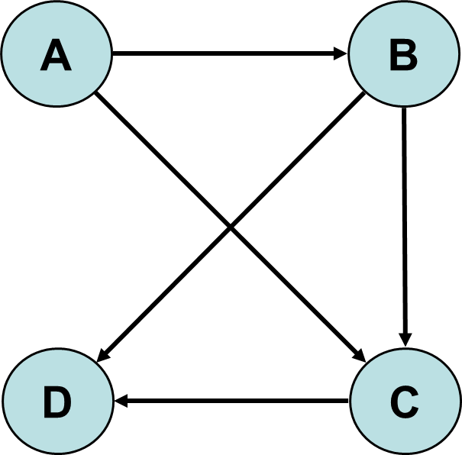
Directed Graphs
A directed graph, sometimes referred to as a diagram, is a graph where the edges are ordered pairs of vertices
This means that the edges (A, B) and (B, A) are different, directional edges in a directed graph.
1-<number>

Slide 11
Outline
Undirected Graphs
Directed Graphs
Weighted Graphs
Common Graph Algorithms
Strategies for Implementing Graphs
1-<number>

Slide 12
Weighted Graphs
A weighted graph, sometimes called a network, is a graph with weights or costs associated with each edge
The weight of a path in a weighted graph is the sum of the weights of the edges in the path
Weighted graphs may be either undirected or directed upon the need
For weighted graphs, we represent each edge with a triple including the starting vertex, ending vertex, and the weight (Boston, New York, 120)
1-<number>
Notes:
In some graphs, edges are given a weight, a number that can represent the physical distance between two vertices, or the time it takes to get from one vertex to another, or how much it costs to travel from vertex to vertex (on airline routes, for example).

Slide 13
An Undirected Weighted Graph
Boston
219
120
225
Philadelphia
New York
320
Roanoke
1-<number>

Slide 14
A Directed Weighted Graph
Boston
219
199
140
205
Philadelphia
New York
225
240
320
Roanoke
1-<number>

Slide 15
Outline
Undirected Graphs
Directed Graphs
Weighted Graphs
Common Graph Algorithms
Strategies for Implementing Graphs
1-<number>

Slide 16
Common Graph Algorithms
There are a number of a common algorithms that may apply to undirected, directed, and/or weighted graphs
These include
  various traversal algorithms
  algorithms for finding the shortest path
  algorithms for finding the least costly path in a network
  algorithms for answering simple questions (such as connectivity)
1-<number>

Slide 17
Traversals
There are two types of graph traversal algorithms
  breadth-first: behaves much like a level-order traversal of a tree
  depth-first: behaves much like the preorder traversal of a tree
One difference: there is no root node present in a graph
Graph traversals may start at any vertex in the graph
1-<number>

Slide 18
Breadth-First Traversal
We can construct a breadth-first traversal for a graph using a queue and an iterator
We will use the queue to manage the traversal and the iterator to build the result
Breadth-first traversal algorithm overview
  enqueue the starting vertex, and mark it as “visited”
  loop until queue is empty
    dequeue first vertex and add it to iterator
    enqueue each unmarked vertex adjacent to the dequeued vertex
    mark each vertex enqueued as “visited”
1-<number>

Slide 19
Breadth-First Example
1
2
4
3
5
7
6
8
9
Queue:
9
6
7
8
3
4
5
1
2
Iterator:
1-<number>

Slide 20

Depth-First Traversal
Use nearly the same approach as the breadth-first traversal, but replace the queue with a stack
Additionally, do not mark a vertex as visited until it has been added to the iterator
1-<number>

Slide 21
Example
5
2
0
1
3
7
4
6
Policy: Visit adjacent nodes in increasing index order

Slide 22
Preorder DFS: Start with Node 5
5
2
0
1
3
7
4
6
5 1 0 3 2 7 6 4

Slide 23
Preorder DFS: Start with Node 5
5
5
2
0
1
3
7
4
6
Push 5

Slide 24
Preorder DFS: Start with Node 5
5
2
0
1
3
7
4
6
Pop/Visit/Mark 5
5

Slide 25
Preorder DFS: Start with Node 5
1
2
5
2
0
1
3
7
4
6
Push 2, Push 1
5

Slide 26
Preorder DFS: Start with Node 5
2
5
2
0
1
3
7
4
6
Pop/Visit/Mark 1
5 1

Slide 27
Preorder DFS: Start with Node 5
0
2
4
2
5
2
0
1
3
7
4
6
Push 4, Push 2, Push 0
5 1

Slide 28
Preorder DFS: Start with Node 5
2
4
2
5
2
0
1
3
7
4
6
Pop/Visit/Mark 0
5 1 0

Slide 29
Preorder DFS: Start with Node 5
3
7
2
4
2
5
2
0
1
3
7
4
6
Push 7, Push 3
5 1 0

Slide 30
Preorder DFS: Start with Node 5
7
2
4
2
5
2
0
1
3
7
4
6
Pop/Visit/Mark 3
5 1 0 3

Slide 31
Preorder DFS: Start with Node 5
2
7
2
4
2
5
2
0
1
3
7
4
6
Push 2
5 1 0 3

Slide 32
Preorder DFS: Start with Node 5
7
2
4
2
5
2
0
1
3
7
4
6
Pop/Mark/Visit 2
5 1 0 3 2

Slide 33
Preorder DFS: Start with Node 5
2
4
2
5
2
0
1
3
7
4
6
Pop/Mark/Visit 7
5 1 0 3 2 7

Slide 34
Preorder DFS: Start with Node 5
6
2
4
2
5
2
0
1
3
7
4
6
Push 6
5 1 0 3 2 7

Slide 35
Preorder DFS: Start with Node 5
2
4
2
5
2
0
1
3
7
4
6
Pop/Mark/Visit 6
5 1 0 3 2 7 6

Slide 36
Preorder DFS: Start with Node 5
4
2
5
2
0
1
3
7
4
6
Pop (don’t visit) 2
5 1 0 3 2 7 6

Slide 37
Preorder DFS: Start with Node 5
2
5
2
0
1
3
7
4
6
Pop/Mark/Visit 4
5 1 0 3 2 7 6 4

Slide 38
Preorder DFS: Start with Node 5
5
2
0
1
3
7
4
6
Pop (don’t visit) 2
5 1 0 3 2 7 6 4

Slide 39
Preorder DFS: Start with Node 5
5
2
0
1
3
7
4
6
Done
5 1 0 3 2 7 6 4

Slide 40
Depth-First Example
1
2
4
3
5
7
6
8
9
Stack:
9
6
7
8
5
2
4
1
3
Iterator:
9
8
5
2
4
1
3
7
6
1-<number>

Slide 41
Testing for Connectivity
A graph is connected if and only if for each vertex v in a graph containing n vertices, the size of the result of a breadth-first traversal at v is n
A
B
Starting Vertex | Breadth-First Traversal
A | A, B, C, D
B | B, A, D, C
C | C, B, A, D
D | D, B, A, C
D
C
Breadth-first traversals for a connected undirected graph
1-<number>

Slide 42
Testing for Connectivity
A
B
Starting Vertex | Breadth-First Traversal
A | A, B, C
B | B, A, C
C | C, B, A
D | D
D
C
Breadth-first traversals for an unconnected undirected graph
1-<number>

Slide 43
Determining the Shortest Path
There are two possibilities for determining the “shortest” path in a graph
  determine the literal shortest path between a starting vertex and a target vertex (meaning the least number of edges between the two vertices)
    simplest approach - implementation is a simple variation of the breadth-first traversal algorithm
  look for the cheapest path in a weighted graph
    use a minheap or a priority queue storing vertex, weight pairs
1-<number>

Slide 44
Outline
Undirected Graphs
Directed Graphs
Weighted Graphs
Common Graph Algorithms
Strategies for Implementing Graphs
1-<number>

Slide 45
Strategies for Implementing Graphs
Adjacency lists
  use a set of graph nodes which contain a linked list storing the edges within each node
  for weighted graphs, each edge would be stored as a triple including the weight
Adjacency matrices
  use a two dimensional array
  each position of the array represents an intersection between two vertices in the graph
  each intersection is represented by a boolean value indicating whether or not the two vertices are connected
1-<number>

Slide 46
Representing an Undirected Graph
A
B
 | A | B | C | D
A | F | T | T | F
B | T | F | T | T
C | T | T | F | F
D | F | T | F | F
D
C
An undirected graph and its adjacency matrix
1-<number>

Slide 47
18.5 – Representing a Directed Graph
A
B
 | A | B | C | D
A | F | T | T | F
B | F | F | T | T
C | F | F | F | F
D | F | F | F | F
D
C
A directed graph and its adjacency matrix
1-<number>

